Slide 1
ElectroChem Cell CAD Models – Dimension
Date Updated: June 29, 2020

Slide 2
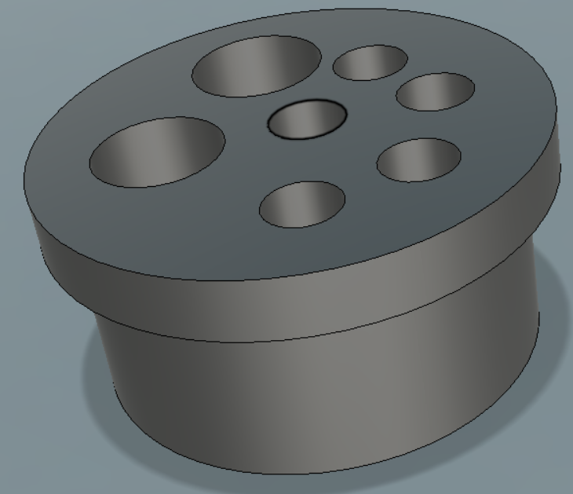
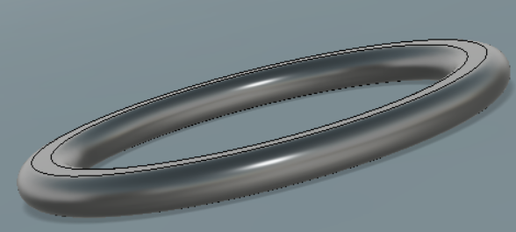
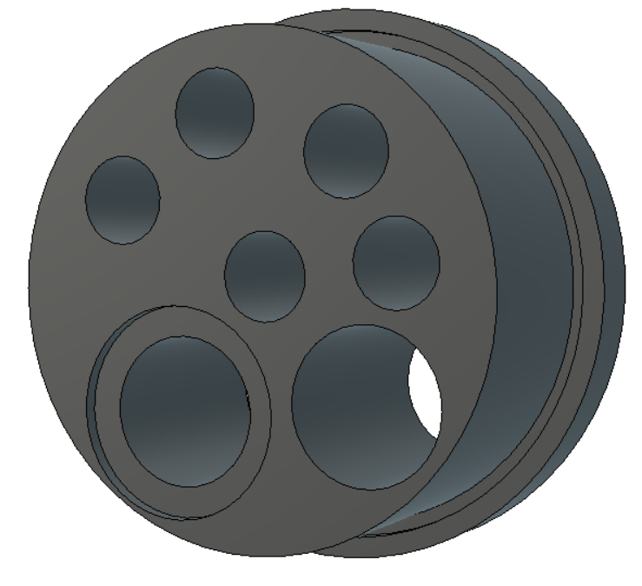
Cell Cap CAD Model
Dimensions
Probe Holder Hole Diameter = 6mm
Outer Diameter = 40mm
O-ring = 35.2 mm
Used to seal into glass tube
O-Ring Placeholder Diameter = 35.2 mm
Groove Diameter = 1mm
Inner Diameter = 34mm; 10mm into the Chamber

Slide 3
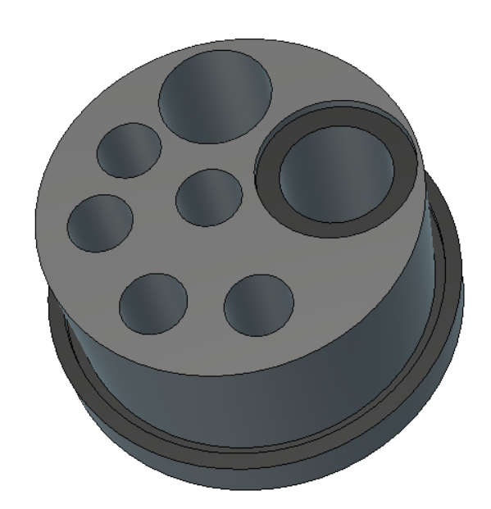
Cell Cap Fittings
Spray Nozzle
(10.28mm Diameter)
Embedded Area for Spray Nozzle Bolt
Tube Insertion
(10.6mm Diameter)
Reference Electrode
(6mm Diameter)
Through Hole
(For Pipetting Fluids)
(6mm Diameter)
Counter Electrode
(6mm Diameter)
Extra Fittings
(6mm Diameter)
* Fittings can be moved in final design to allow for more space for different probes

Slide 4
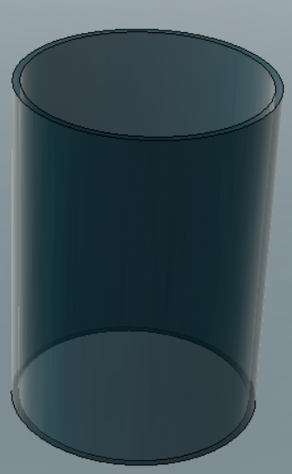
Glass Chamber CAD Model
Dimensions
Height – 50mm
Outer Diameter – 38mm
Inner diameter – 35.2mm

Slide 5

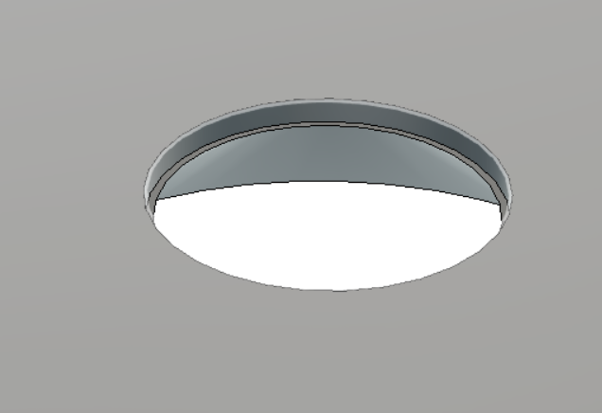
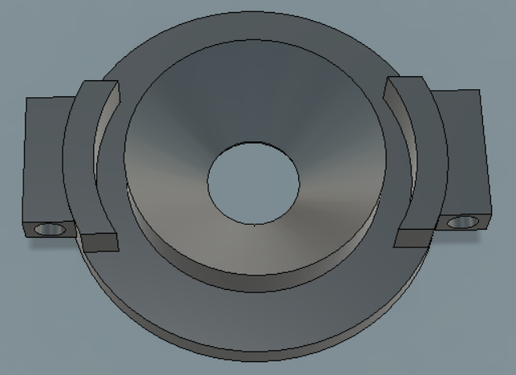
Bottom Casing CAD Model
Dimensions
Open Hole Diameter =10mm
Outer Diameter = 50mm
Embedded O-Ring Placeholder Diameter = 10mm ; 1mm into casing
Glass Cell Groove = 5mm
O-Ring Seal Wrapped around Conical center
Seals the chamber to the casing
Glass Chamber will go 5mm into Bottom Casing

Slide 6
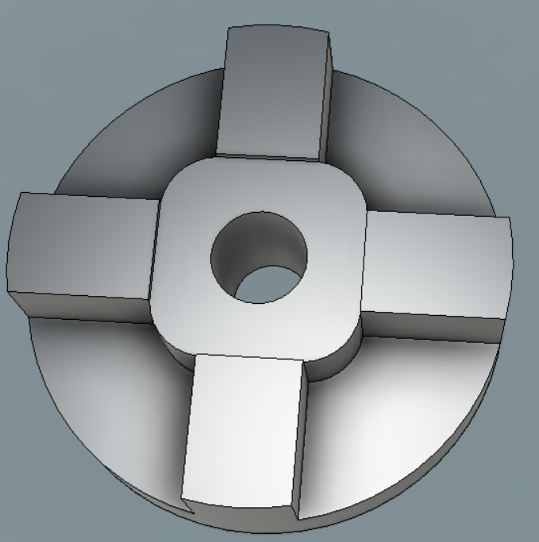
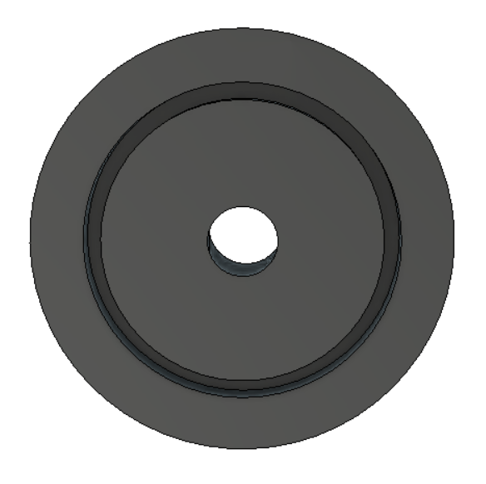
Sample Casing Redesigned CAD Model
Dimensions
Outer Diameter – 60mm
Drain Diameter – 10mm
Corner Clearance – 10mm
Square Glass Slide Bed – 26mm x 26mm

Slide 7
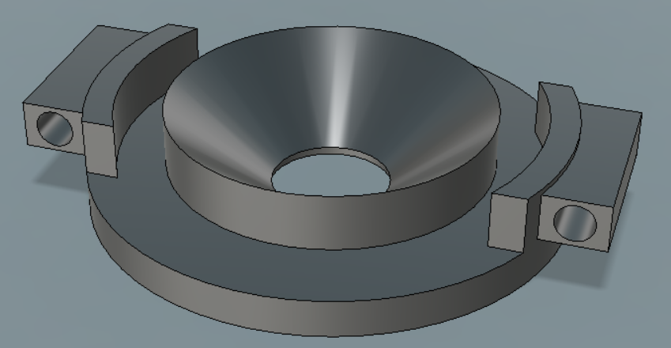
Pneumatic Lift Attachment
How it Will Work
Bottom Casing Redesigned to have “Wings”
Pneumatic lift will have extended arms that fit inside designed holes (4mm diameter)
Wing Sizing = 18mm x 5mm (5mm Extruded from base)

Slide 8
Separation
10 cm??

